Slide 1
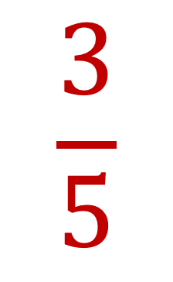
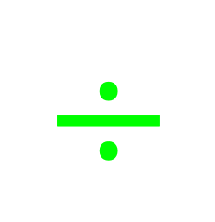
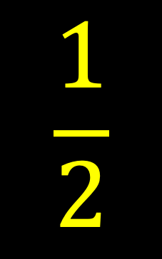



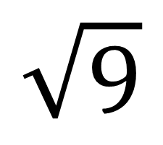


Topic: Factorising Non-Monic Trinomials EQ: How does the process for factorising non-monic differ from monic?
$$÷$$
$$−$$
$$\frac{3}{5}$$
$$×$$
$$5^{2}$$
$$\frac{1}{2}$$
$$\sqrt{9}$$
$$7$$
$$+$$

Slide 2
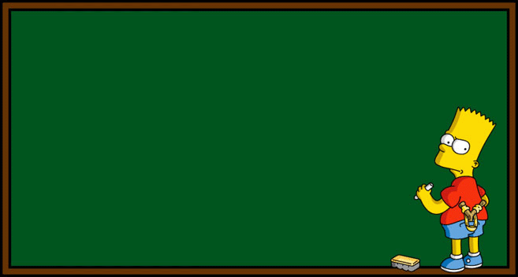
Factorising Quadratics
Grade B/A
10/03/2020
Learning Objectives:
Know what the sum and product is
Able to expand two brackets
Able to factorise a quadratic expression

Slide 3



Factorising Quadratics
Topic: Factorising Non-Monic Trinomials EQ: How does the process for factorising non-monic differ from monic?
sum → +6
product → +8
$x^{2}$ + 6$x$ + 8
$x^{2}$ + 6$x$ + 8
$x^{2}$ + 6$x$ + 8
($x$ )($x$ )
What two numbers have a product of +8 and a sum of +6?
+ 4
+ 2
1, 8
8, 1
2, 4
4, 2

Slide 4
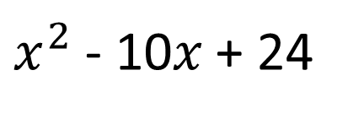
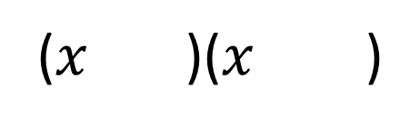
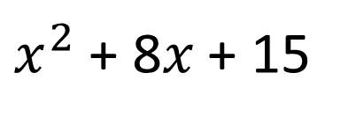
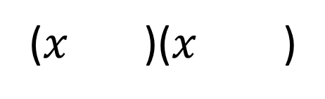
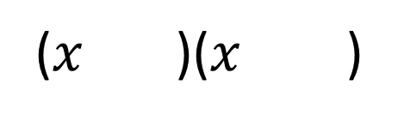
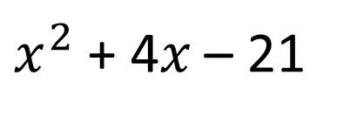
Factorising Quadratics
$x^{2}$ + 8$x$ + 15
$x^{2}$ + 4$x$ – 21
$x^{2}$ - 10$x$ + 24
s = +8
p = +15
s = +4
p = - 21
s = -10
p = +24
($x$ )($x$ )
($x$ )($x$ )
($x$ )($x$ )
+ 5
+ 3
+ 7
- 3
- 6
- 4

Slide 5
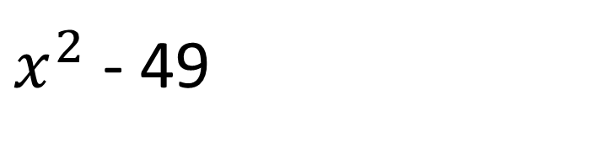
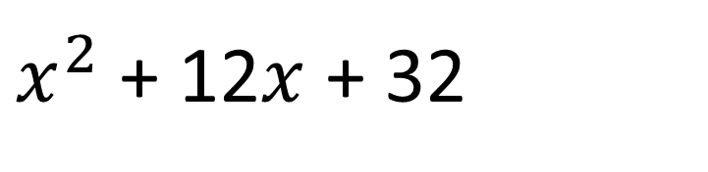
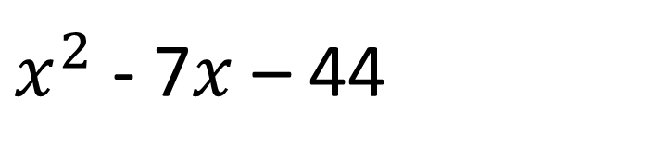
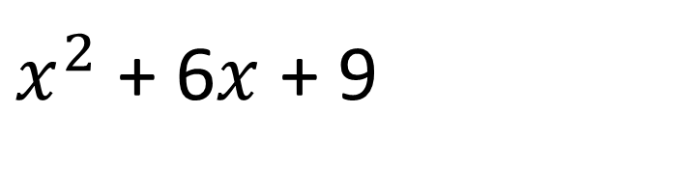
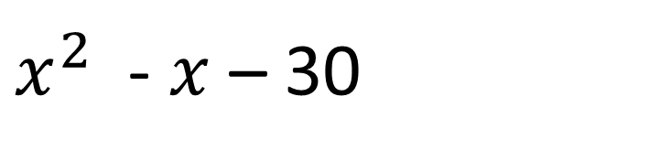
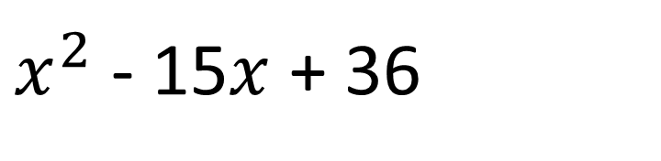
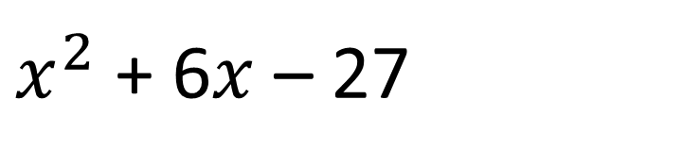
Factorising Quadratics
On your whiteboards:
$x^{2}$ + 12$x$ + 32
$x^{2}$ - 49
$x^{2}$ + 6$x$ + 9
$x^{2}$ - 15$x$ + 36
$x^{2}$ - 7$x$ – 44
$x^{2}$ - $x$ – 30
$x^{2}$ + 6$x$ – 27

Slide 6
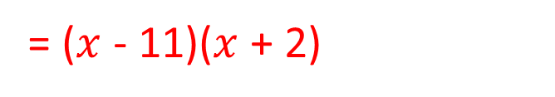
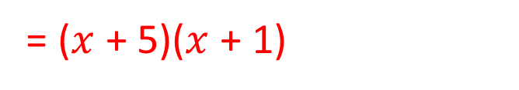
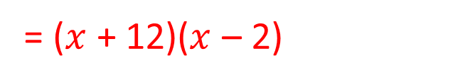
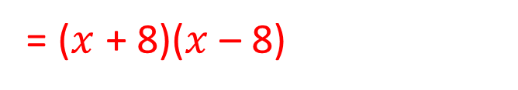

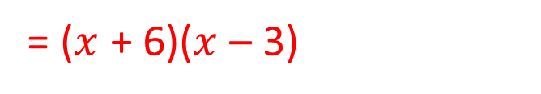
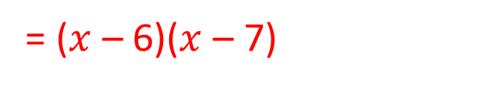
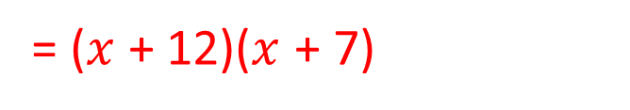
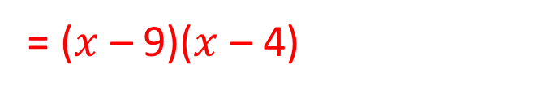
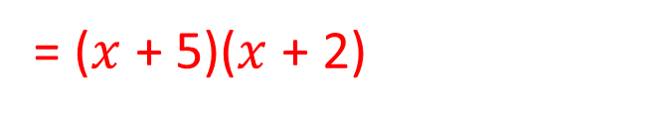
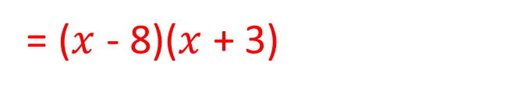
Factorising Quadratics
Factorise the following quadratic expressions:
$x^{2}$ + 6$x$ + 5
$x^{2}$ + 7$x$ + 10
$x^{2}$ + 19$x$ + 84
$x^{2}$ + 3$x$ – 18
$x^{2}$ + 10$x$ – 24
$x^{2}$ - 9$x$ – 22
$x^{2}$ - 5$x$ – 24
$x^{2}$ - 13$x$ + 36
$x^{2}$ - 13$x$ + 42
$x^{2}$ - 64
= ($x$ + 5)($x$ + 1)
= ($x$ + 5)($x$ + 2)
= ($x$ + 12)($x$ + 7)
= ($x$ + 6)($x$ – 3)
= ($x$ + 12)($x$ – 2)
= ($x$ - 11)($x$ + 2)
= ($x$ - 8)($x$ + 3)
= ($x$ – 9)($x$ – 4)
= ($x$ – 6)($x$ – 7)
= ($x$ + 8)($x$ – 8)

Slide 7

Starter
Factorise:
$x$² + 13$x$ + 30
$x$² – 4$x$ – 45
$x$² – 12$x$ + 36
$x$² – 9

Slide 8
Difference of Two Squares
Grade B/A
10/03/2020
Learning Objectives:
Able to factorise simple quadratics
Able to factorise a difference of two squares
Able to factorise more difficult quadratics

Slide 9

Difference of two squares
Topic: Factorising Non-Monic Trinomials EQ: How does the process for factorising non-monic differ from monic?
$$(x+8)(x −8)$$
$x^{2}$ + 8$x$ - 8$x$ – 64
$x^{2}$ - 64

Slide 10


Difference of two squares
$$x^{2} −81$$
$$x^{2} −100$$

Slide 11


Difference of two squares
$${101}^{2} − {99}^{2}$$
= (101 + 99)(101 – 99)
= 200 x 2
= 400
49 – $(x −3)^{2}$
[7 + ($x$ – 3)][7 – ($x$ – 3)]
($x$ + 4)(10 – $x$)

Slide 12
Factorising Quadratics
Pages 140 – 141
Exercise 9F, Q2
Exercise 9G, Q1 (a – e)
Exercise 9G, Q1 (f – i), Q2

Slide 13
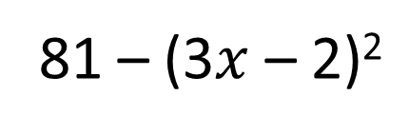
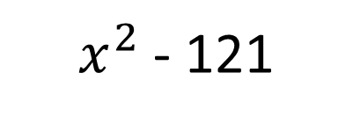

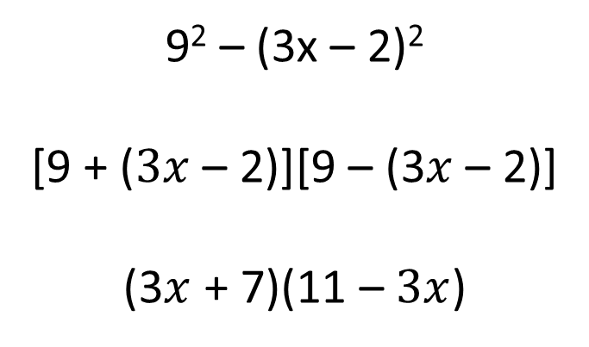
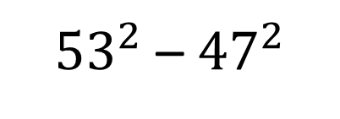
Starter
$x^{2}$ - 121
${53}^{2}$ – ${47}^{2}$
81 – (3$x$ – 2)²
$$(x+11)(x −11)$$
= (53 + 47)(53 – 47)
= 100 x 6
= 600
9² – (3x – 2)²
[9 + ($3x$ – 2)][9 – (3$x$ – 2)]
(3$x$ + 7)(11 – $3x$)

Slide 14
Factorising Quadratics
Pages 140 – 141
Exercise 9F, Q2
Exercise 9G, Q1 (a – e)
Exercise 9G, Q1 (f – i), Q2

Slide 15
Factorising Quadratics
Grade A
10/03/2020
Learning Objectives:
Know what the sum and product is
Able to expand two brackets
Able to factorise a quadratic expression

Slide 16

Factorising Quadratics
Topic: Factorising Non-Monic Trinomials EQ: How does the process for factorising non-monic differ from monic?
$$(3x – 2)(4x + 3)$$
$$12x^{2} −8x+9x −6$$
$$12x^{2}+x −6$$

Slide 17

Factorising Quadratics
s = +11
p = 2 x +15
= +30
$$2x^{2}+11x+15$$
$$2x^{2}+6x+5x+15$$
$$2x\left(x+3\right)+5\left(x+3\right)$$
$$(2x+5)(x+3)$$
What two numbers have a product of +30 and a sum of +11?

Slide 18

Factorising Quadratics
s = -33
p = 5 x -14
= -70
$$5x^{2}−33x−14$$
$$5x^{2}−35x+2x−14$$
$$5x\left(x−7\right)+2\left(x−7\right)$$
$$(5x+2)(x−7)$$
What two numbers have a product of -70 and a sum of -33?

Slide 19

Factorising Quadratics
s = -11
p = 6 x +3
= +18
$$6x^{2}−11x+3$$
$$6x^{2}−9x−2x+3$$
$$3x\left(2x−3\right)−1\left(2x−3\right)$$
$$(3x−1)(2x−3)$$
What two numbers have a product of +18 and a sum of -11?

Slide 20
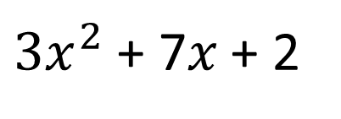
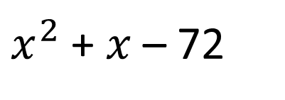
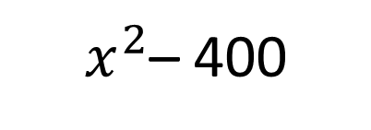
Starter
$x^{2}$ + $x$ – 72
$x^{2}$– 400
${3x}^{2}$ + 7$x$ + 2

Slide 21
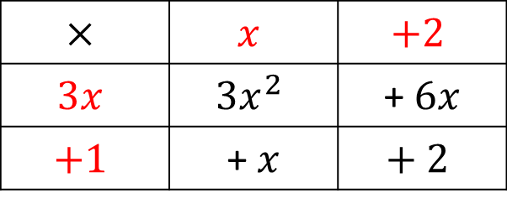





Factorising Quadratics
$$(3x + 1)(x + 2)$$
$$×$$ | $$x$$ | $$+2$$
$$3x$$ | $$3x^{2}$$ | +$6x$
$$+1$$ | + $x$ | $$+ 2$$
= 3$x$²
+ $6x$
+ $x$
+ 2
= $3x^{2}+7x+2$

Slide 22











Factorising Quadratics
Factorise: $5x^{2}+36x+7$
$$x$$
$$+7$$
$$×$$
$$5x$$
$$5x^{2}$$
$$+35x$$
$$+1$$
$$+x$$
$$+ 7$$
$$(5x + 1)(x + 7)$$

Slide 23









Factorising Quadratics
Factorise: $2x^{2}+11x+12$
$$x$$
$$+4$$
$$×$$
$$2x$$
$$2x^{2}$$
$$+8x$$
$$+3$$
$$+3x$$
$$+ 12$$
$$(2x +3)(x +4)$$

Slide 24









Factorising Quadratics
Factorise: $3x^{2}−2x−21$
$$x$$
$$−3$$
$$×$$
$$3x$$
$$3x^{2}$$
$$−9x$$
$$+7$$
$$+7x$$
$$−21$$
$$(3x +7)(x −3)$$

Slide 25











Factorising Quadratics
Factorise these quadratics:
${2x}^{2}+7x+3$
$3x^{2}+14x+8$
$5x^{2}+13x+6$
$2x^{2}+9x+9$
${11x}^{2}+34x+3$
${3x}^{2}+x −4$
${2x}^{2}+3x−14$
${3x}^{2}−11x+10$
$5x^{2}−47x+56$
${ 6x}^{2}+17x+5$
= ($2x$ + 1)($x$ + 3)
= ($3x$ + 2)($x$ + 4)
= ($5x$ + 3)($x$ + 2)
= ($2x$ + 3)($x$ + 3)
= ($11x$ + 1)($x$ + 3)
= ($3x$ + 4)($x$ – 1)
= ($2x$ + 7)($x$ – 2)
= ($3x$ – 5)($x$ – 2)
= ($5x$ – 7)($x$ – 8)
= ($2x$ + 5)($3x$ + 1)

